Slide 1
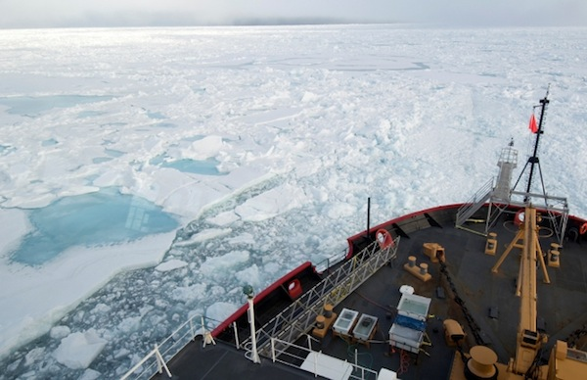
ADAC Year 6
Project Update
Great Lakes Ice Conditions Index (ICECON)
Jifeng Peng, University of Alaska Anchorage
Shawn Butler, University of Alaska Anchorage
Kelsey Frazier, University of Alaska Anchorage

Slide 2
ADAC Project: Arctic Ice Conditions Index (ARCTICE) and ICECON for the Great Lakes
Project Principal Investigator(s)
  Dr. Jifeng Peng, University of Alaska Anchorage
Supporting Team
  Dr. Shawn Butler, University of Alaska Anchorage
  Kelsey Frazier, University of Alaska Anchorage
Project Champions
  CDR Christopher Tuckey, CG-WWM
  LCDR James Gatz, CG-WWM
Project Support
  Sam Cheung, CG RDC
Project Collaborators
  Jonathan Edwards-Opperman, NIC
  Lt. Jason Radcliffe, CG D9
  Capt. (Ret) Phillip Thorne, CG D17
  Axiom Data Science

Slide 3
Great Lakes ICECON Classification
Total Score | ICECON | Impacts to Vessels
0 | 0 | No Ice present or imminent.
0-15 | 1 | Minimum ice concentrations and thickness. Does not present hindrance to commercial navigation.
16 -30 | 2 | Light Ice conditions present. Still open water areas. May be some hindrance to less ice-capable ships.
31 -50 | 3 | Light-to-moderate ice conditions present. Less ice-capable ships may need icebreaker assistance for transit and/or be at risk for damage.
51 -75 | 4 | Moderate-to-Heavy Ice conditions present. All Commercial ships may require icebreaker assistance for transit.
>75 | 5 | Heavy-to-extreme ice conditions. All transits require icebreaker escort.

Slide 4
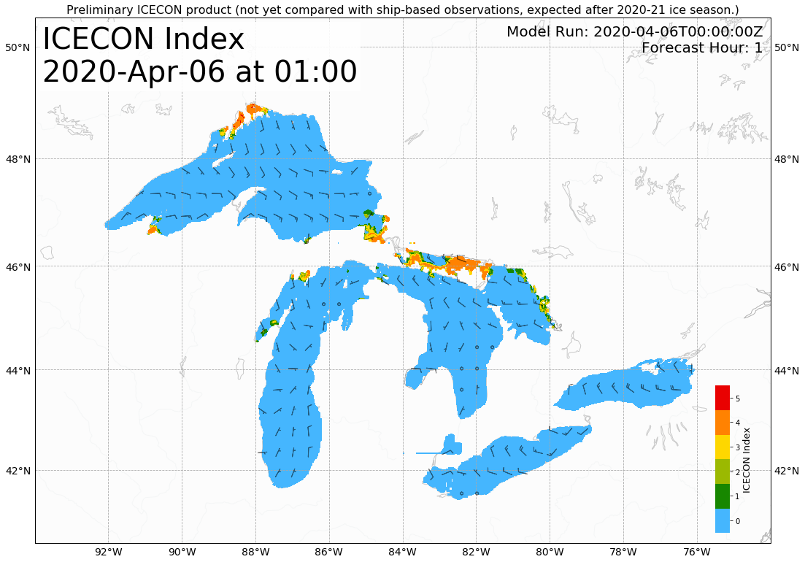
GL ICECON forecast at 1 hr out

Slide 5

GL ICECON forecast at 6 hrs out

Slide 6
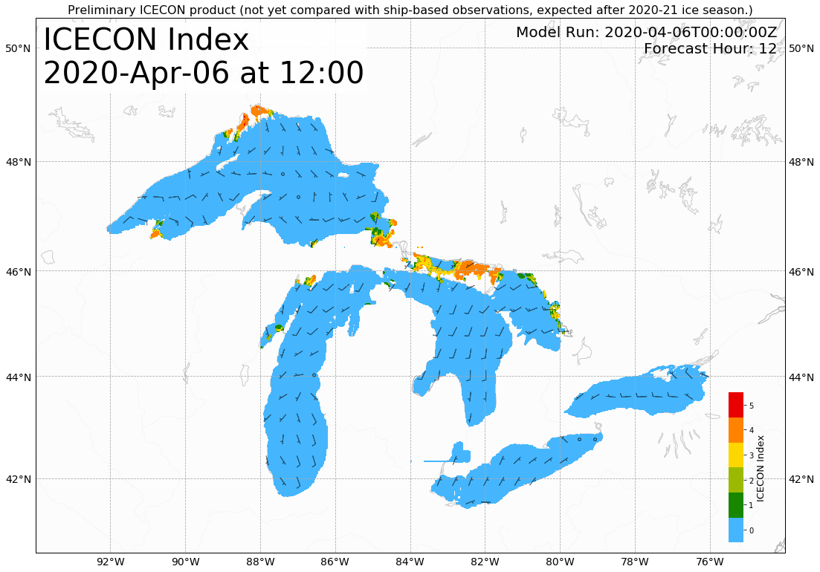
GL ICECON forecast at 12 hrs out

Slide 7

GL ICECON forecast at 24 hrs out

Slide 8

GL ICECON forecast at 48 hrs out

Slide 9

GL ICECON forecast at 72 hrs out

Slide 10
Great Lakes ICECON Project Status
Great Lakes ICECON automation completed
Email distribution setup (principally for USNIC)
Currently doing the trial runs
Start product distribution in a week
Draft user technical documentation completed
Documentation webpage currently in construction

